Slide 1
Our search for 3-D Data
in a Flat Statistical World
Notes:
Our search started when I asked our IT department to give me a dashboard that compiled as many of our statistics as we could. This proved to be a daunting task for an overburdened group. In the meantime I attended an LJ conference on Outcomes that made clear the need to have outcome data, rather than the one-dimensional output data we have been collecting. At that conference I talked to a vendor about our struggle to build a dashboard and he told me the reason we were having a hard time is that it is hard to do. One conversation led to another and we realized that our need was much greater than a handy dashboard for our numbers. We needed to rethink our entire organizational strategy in order to stay relevant to the needs of our customers and our funders.

Slide 2
Prince George’s County Memorial Library System/Orange Boy
Market Analysis and Dashboard Development Project
July 2011-Present
Project Goals
Identify Library behaviors of users and non-users
Understand the needs of targeted segments
Define the outcomes PGCMLS should seek to achieve for its customers
Develop a product and service process to generate the desired outcomes
Measure the defined cluster outcomes to evaluate progress
Notes:
Our project began in July, 2012 with these goals taken from our 2011-2015 Strategic Plan. As we worked with Orange Boy, providing our statistical data on registered borrowers, their borrowing and other library behaviors, our costs and our County’s demographic data organized by areas of influence (areas around our branch libraries from which library users come), we discovered that many of our beliefs were borne out by the data, but also that some were not.

Slide 3
PGCMLS Cluster Breakdown
Notes:
What strikes me here is the great diversity of use. We don’t see any one group really dominating the landscape.

Slide 4
Cluster Overview
Name | Heavyweights | Staying Connected | The Brainy Bunch | Inquisitive Minds | Occasionals | The Dependables
Primary Use | Borrow adult print materials | Use a Library Computer | Borrow children’s materials & attend children’s activities | Work, study, or use free Wi-Fi | Borrow adult print materials | Borrow Print and A/V materials
% of respondents | 14.9% | 13.7% | 13.6% | 11.0% | 10.9% | 8.2%
Visit frequency | Heavy | Heavy | Heavy | Varies | Light | Heavy
Reading behaviors | 20+ books read per year | 11-19 books read per year | 11-19 books read per year | 11-19 books read per year | 1-10 books read per year | 20-29 books read per year
Complementary behaviors | Browse shelves for reading materials, pick up items on hold/reserve | Browse shelves for reading materials, research a specific topic, study or work | Browse shelves for reading materials | Browse shelves for reading materials | Browse shelves for reading materials, pick up items on hold/reserve | Browse shelves for reading materials, pick up items on hold/reserve, research a specific topic
% currently owning an eReader/tablet | 41% | 40% | 51% | 45% | 38% | 50%
% planning to own eReader/tablet | 18% | 25% | 18% | 20% | 19% | 15%
% with children < 18 | 21% | 36% | 85% | 31% | 24% | 30%
Notes:
The first aspect to be developed was customer behaviors, or Clusters.

Slide 5
Cluster Overview
Name | New Wave | Audiophiles | Transitionals | Digitarians | Double Feature
Primary Use | Borrow teen materials | Borrow audiobooks or eAudiobooks | Borrow adult print and eBooks | Borrow eBooks | Borrow A/V materials
% of respondents | 8.2% | 6.1% | 4.2% | 5.3% | 4.0%
Visit frequency | Moderate | Moderate | Moderate | Light | Moderate
Reading behaviors | 20-29 books read per year | 20-29 books read per year (listened to) | 20-29 books per year | 20-29 books read per year | 6-10 books read per year
Complementary behaviors | Browse shelves for reading materials, pick up items on hold/reserve | Browse shelves for reading materials, pick up items on hold/reserve | Browse shelves for reading materials, pick up items on hold/reserve, research a specific topic | Use catalog on library website, pick up items on hold/reserve | Use catalog on library website, pick up items on hold/reserve
% currently owning an eReader | 44% | 67% | 88% | 97% | 34%
% planning to own eReader | 22% | 11% | 7% | 1% | 14%
% with children < 18 | 30% | 23% | 24% | 27% | 25%
Notes:
We identified 11 distinct types of customer behaviors by looking at customer demographic data, borrowing patterns and customer surveys.

Slide 6
Total Cluster Cost
Notes:
We were able to arrive at approximate costs for each type of customer, based mainly on the resources they use.

Slide 7
Notes:
One of the elements we plotted was the MSA Proficiency Scores around each of our branch libraries-the Area of Direct Influence and to compare the scores to the County as a whole and to the state of Maryland. This is critical information that helps us align our goals with our County’s initiative to improve educational outcomes.

Slide 8
Notes:
Another major breakthrough emerged when we were able to use the similarities in clusters, demographics and geography to combine our 19 branches into 5 Areas. We began to see that it would be possible to restructure management using the data, whereby each of 5 Area Managers could readily develop service plans for 3 to 4 branches based on the analysis of customer behavior and the priorities of our Strategic Plan.

Slide 9
Branch Area Outcomes
Group branches to allow easy access to customer base
Serve common needs, allowing library to focus human and capital resources
Create shared outcomes, generating a measurable process

Slide 10
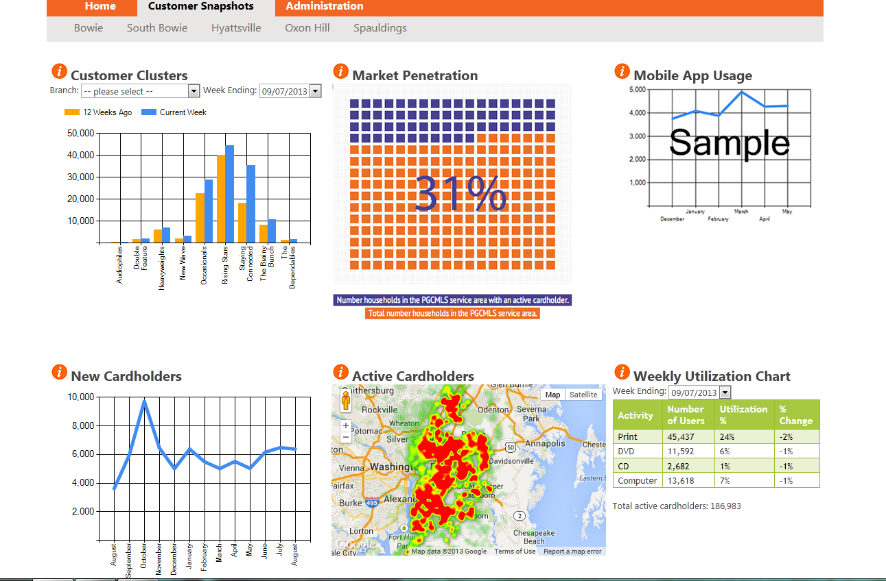
Notes:
This is the dashboard that shows weekly data for the entire system by customer behavior group or “Cluster”. We were surprised that our Market Penetration is only 31%. We assumed that because the number of registered cardholders is about 50% of the population of the county, that half the county are users. This data shows that of all county residents, only 31% are actively using our libraries and resources. However, we also realized that a large number of people were using our services without having library cards-computer users, primarily. We instituted a Computer Access Only library card so we could track computer use. We hope to be able to follow what these users do and to persuade them to convert to a full-privilege borrower’s card.

Slide 11
Market Penetration
Ratio of total households in the county compared to those households that have at least one active library user in a household.
Updated weekly.
Notes:
These are the data that give us the charts.

Slide 12
New Cardholders
Number of new cardholders at each library.
Updated monthly.

Slide 13
Active Cardholders
Have used our library in the last 12 months.
Shows where our active cardholders reside.
The areas in red show the highest concentration of active users, showing where we have significant density.
Updated weekly.

Slide 14
Weekly Utilization Chart
Summarizes how patrons are using the library (print, CD, and DVD materials), as well as computer logins.
Calculated as percent of active library users.
Tracks the percent of change in resource use from the previous week.

Slide 15
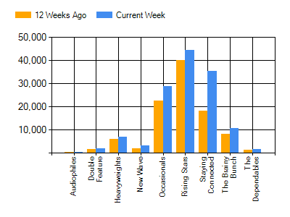
Customer Clusters
Cluster Names
Audiophiles
Double Feature
Heavyweights
New Wave
Occasionals
Rising Stars
Staying Connected
Brainy Bunch
Dependables
Notes:
Clusters are groups of customer behaviors defined by demographic information and by their behavior when they use the library. A variety of data was used including library card registration, census data, circulation records and customer surveys.

Slide 16
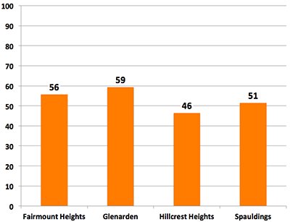
Risk Index
Poverty,
Female head of household,
Second language at home
Passage rate on the 3rd grade reading test for public schools in our area of dominating influence (ADI).
Updated annually.
Notes:
This is an extremely powerful chart because it helps us to align our priorities with the educational goals of Prince George’s County. We are also able to assign resources where they are most needed, and not necessarily where we think they are needed.

Slide 17
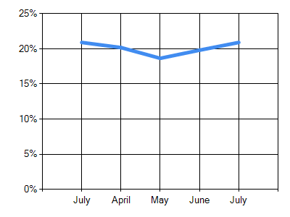
Collection Velocity
Ratio of holdings to the number circulated over a month’s time.
Helps target collection development plans
Gives insight to and building floor plans.
Updated monthly.
Notes:
This is one of our favorite charts because it provides a powerful visual of trends as well as turnover rates for our collections.

Slide 18
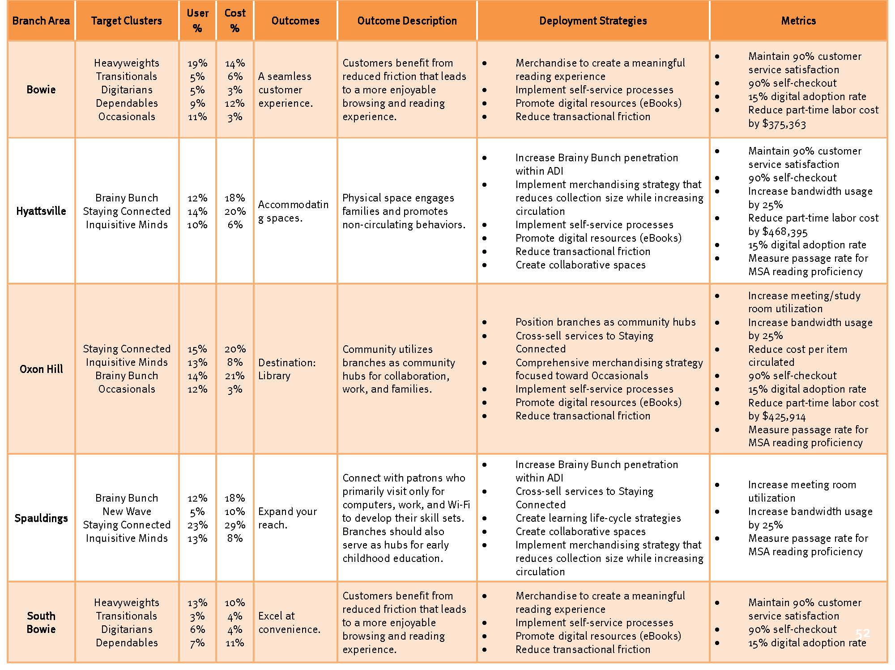
Notes:
Each Area now has a matrix from which to plan strategies to achieve outcomes that reflect the library system’s priorities. Metrics in the farthest right column show progress. From this, Area Managers are developing plans for achieving the specified outcomes.

