Slide 1
Collection Development/
Technical Services Workflow
Re-engineering
Notes:
How good data and careful analysis helped BCPL dramatically improve materials processing workflow, speed and through-put.

Slide 2
The Context:
We do/did it all ! And lots of it!
Items processed…20% growth
Staffing to do the work…not so much
Notes:
Complete in-house processing of most items from unpacking boxes at the loading dock to shipping fully-processed items out to branches.
Process around 500,000 items annually; almost 10,000 weekly
Healthy materials budget
In previous 4 years before project , # of items processed had grown by 20%
At same time, staffing levels had not significantly changed.

Slide 3
The Problem:
Not keeping up
Backlogs---Up to 27 days
Fast or very slow
Lots of “RUSH”
Layers of process…but why?
Notes:
We ended up with 2 timeframes for materials moving through the department: very fast and very slow.
Backlogs …Some materials were “rushed” and took a day or two, others took as long as 28 days from receipt to delivery to branches
This led to an over-use of “Rush” status to ensure that materials were handled in a timely manner, but the practice had the opposite effect since the continual stream of Rush materials interrupted the regular flow and slowed down the entire process.
For most libraries the percentage of materials handled as Rush was under 3-5% of the total materials ordered, compared to BCPL, which on occasion reached as high as 30%.
Over time we had developed complicated processes and workflows, with specialized flows for print versus AV.
…Even specialized work assignments—some staff did only AV, or only print.

Slide 4
Goals:
To get all BCPL’s print and non-print materials out to our customers as quickly and efficiently as possible
To re-engineer a functional, but not great working process to make it optimal!
Notes:
To get all BCPL’s print and non-print materials out to our customers as quickly and efficiently as possible
To re-engineer a functional, but not great working process to make it optimal!

Slide 5
THE Question:
What would it take to get 95% of new materials out to customers in 10 days or less, without adding additional staff?
Notes:
This was our guiding premise…and the ultimate test of whether or not we would succeed.
What would it take to get 95% of new materials out to customers in 10 days or less, without adding additional staff?

Slide 6
How we did it:
Brainstorm
Deconstruct
Ask lots of questions: 5 Whys /Sacred Cows
Map Workflows
Measure and Analyze
Redesign and Rebuild
Test and Refine
Quality Control
Continuous Process Improvement
Notes:
Since we could not shut down operations to make these changes all at once, we went through this process step by step, while still maintaining a reasonable production throughout.
I was project manager, having had recent experience in both Coll Dev and Cataloging/Tech Services.

Slide 7
Brainstorming
4 sessions w/internal stakeholders
Less taping, labeling, stamping, etc.
Conveyer belt
Carts only, no shelves
Rush everything; Rush nothing
Motorized carts
Volunteers
Notes:
We knew it was vital to ENGAGE INTERNAL STAKEHOLDERS FROM THE START, so we…
4 brainstorming sessions with mixed groups of staff from acquisitions, processing, cataloging, and collection development
Some of the ideas:
Conveyer belt from dock through departments
Less taping, labeling, stamping, etc.
Carts only, no shelves
Rush everything; Rush nothing
Motorized carts
Volunteers

Slide 8
Deconstruction
Dissect every process
Why, Why, Why, Why, Why?
Notes:
WE DISSECTED EVERY PROCESS
Documented every step in every task
Asked lots of questions, challenged assumptions and practices, and asked folks to confront their Sacred Cows
5 Whys –to get at root causes

Slide 9
Workflow Mapping
Seeing is Believing !
Mapped process and physical pathways for each material type
Crazy spaghetti !
Notes:
Who knew things had gotten so complicated? Seeing is believing. We did a spaghetti map of all our workflows.
We tracked the physical path of each type of material being processed, from receipt at loading dock, through unpacking, cataloging, gathering, processing, clearing, and delivery, and recorded each path as a colored line on a enlargement of the Coll Dev/Technical Services floor plan.
What we found: Crazy Spaghetti !!!
Staff skills, or lack of skills, task preference, and even workstation preference were driving the workflow …rather than other way around.
Lots of repetitive moving of items from boxes, to shelves, to carts, to shelves, back to carts, to a series of workstations via carts, and back to shelves, then carts, and finally delivery boxes.

Slide 10
Measurement and Analysis
Established key metrics
Repetitive tasks and nonproductive elements
Production per hour/per staff
Looked for efficiencies: Music CD Security Cases
Task timings
Notes:
We established some key metrics, like # of items on an average cart, and staffing and performance thresholds
Identified and documented Repetitive handling situations and non-value-added times between tasks or steps.
Calculated Production per hour/per staff – production was tracked and measured by cart, by staff hour, and by shift output
Music CD Security Cases –data collection on CD collection loss rates compared to circ and collection size; time studies on how much time to put CDs in cases during initial processing, to cut up and duplicate packaging, then how much time in the branches when they are checkout in and out, etc. Decision to no longer put CDs in cases, for all collections except highest theft areas (Rock, Pop).
And…We timed everything –every action, process step and task was identified, and measured or timed.

Slide 11
 |  |  |  |  | Time in | Time in | Average time in
 | Date | Material | Job | # of items | minutes | seconds | seconds per item
Step 1 | 6/11/2007 | Rush-book | Pre-Assigning | 82 | 17.38 | 1,058 | 13
Step 2 | 6/11/2007 | Rush-book | Assigning | 26 | 7.14 | 434 | 17
 |  | Rush-book | Assigning | 82 | 23.45 | 1,425 | 17
Step 3 | 6/11/2007 | Rush-book | Covering | 26 | 9.16 | 556 | 21
 |  | Rush-book | Covering | 82 | 37.04 | 2,224 | 27
Step 4 | 6/12/2007 | Rush-book | Glueing | 51 | 6.17 | 377 | 7
 |  | Rush-book | Glueing | 22 | 2.17 | 137 | 6
Step 5 | 6/12/2007 | Rush-book | Sort into bins | 115 | 7.26 | 446 | 4
Total time | Minimum |  |  |  | 1.01 |  | 61
Total time | Maximum |  |  |  | 1.05 |  | 65
 | Assigning steps for processing hard back books with covers
 | Step 1- Verify # of items, place spine label and BCPL stickers on book, then place back on cart
 | Step 2- Stamp branch lable with date on item, place barcode label on book note item # on conversion
 | sheet, then place back on cart
 | Step 3- Measure book size, get plastic covers, place on books and place new sticker in item, then
 | place item back on cart
 | Step 4- Glue cover on item and place back on cart
 | Step 5- Sort items on to shelves to be delivered to branches
Notes:
Here is an example of just one of those timings.

Slide 12
Redesign
“Time-Certain” workflow model.
-predetermined # of days (10-12)
-single fast workflow
-fewer workflow “exceptions”
Integrated print and non-print workflows.
Streamlining…lots of streamlining!
“Cart” model for material storage and movement.
Cataloging in advance
Centralized filling of holds
Notes:
Adopted “Time-Certain” workflow model. In contrast to our previous “Rush-Non Rush” /fast-slow workflow model, Time-Certain moves all materials through the process in a predetermined number of days (our goal is 10-12 days), thereby ensuring a single fast workflow while minimizing the need for workflow “exceptions”. Our goal was to have Time-Certain in place and fully functional within a year.
Integrated print and non-print workflow. To streamline production and work assignments, and in support of Time-Certain, we merged print and non-print items into a single workflow.
We streamlined—everywhere we could! We analyzed each Collection Development and Technical Services task and work process, and implemented simplification measures wherever feasible.
Adopted the “Cart” model for material storage and movement. All material was now placed on sequentially numbered carts rather than shelves—this minimized repetitive handling and shifting of materials in the Acquisitions-Cataloging-Processing work cycle, eliminated the temptation for things to sit on shelves, and fostered a sequential, not selective work flow.
Cataloging in advance—catalog the item before it even arrives—from OCLC record. Saves time and steps in workflow.
Centralized filling of holds on new materials through Technical Services to lessen the impact on delivery.

Slide 13

Processing, packaging and labeling modifications
Rethought RUSH ( 3-5% , not 30-40% )
Evened out collection spending (% per month)
Cross-trained everyone!
Flexible, proactive use of staff time to meet workload needs
Established, then leaned on, accountability and production standards.
Notes:
Processing, packaging and labeling modifications. We instituted numerous internal modifications to minimize processing steps and times for materials of all types, to reduce labor-intensive packaging and repackaging, and to reduce and standardize materials labeling.
Rethought rushes. The process of identifying and handling “rush” materials from time of order to completion of processing was revised and streamlined in anticipation of “Time-Certain”. Established 3-5% of output as RUSH as new standard.
Modification of Coll Dev spending over the buying year… % per month, and a heightened ordering pace, in part to lessen the potential for periodic Technical Services backlogs.
Cross-trained staff. To increase speed and efficiency and to maximize deployment of staff, Technical Services staff was cross-trained to perform processing functions in print and non-print areas.
Flexible and proactive use of staff time to meet AND anticipate workload needs, minimize backlogs, and reduce big fluctuations in workload
Set up and enforced accountability and production standards, as well as workflow management expectations.

Slide 14
Notes:
As a result of all these steps, workflow went from this

Slide 15
Notes:
To This!

Slide 16
Rebuild
Make the physical work spaces reflect and support the new workflow
Staff move to where the work is.
Notes:
We soon realized that our physical layout was working against our new workflow…thus
Phase 2—we conducted a redesign and renovation of the10,000 sq ft technical services and collection development areas to reflect and support the new workflow.
We pulled down EVERY shelving unit in Receiving; tore down walls and built new ones; completely reconfigured the layout and relationship of the 4 major work units: Coll Dev, Receiving, Cataloging, and Processing; and refurnished each one to support the new workflow model
Processing Staff now moved to where the work was—far more efficient!
And at last, the workflow and the space worked together.

Slide 17
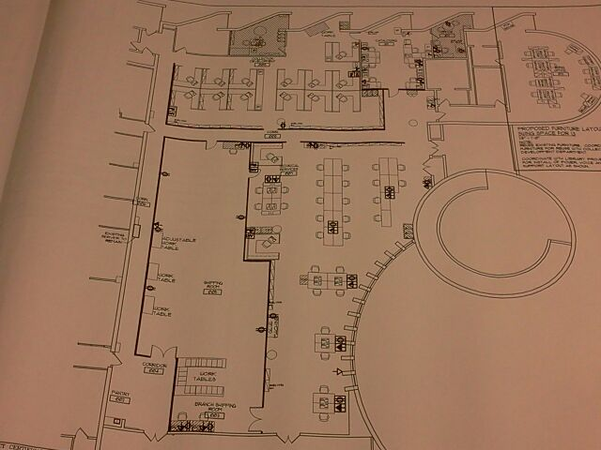
4
3
5
2
6
1
7
Notes:
Redesigned physical space to reflect the new single-stream workflow:
1 Dock, 2 unpacking onto carts, 3 staging, 4 gathering, 5 physical processing, 6 tag activation and holds trapping, 7 out to delivery

Slide 18
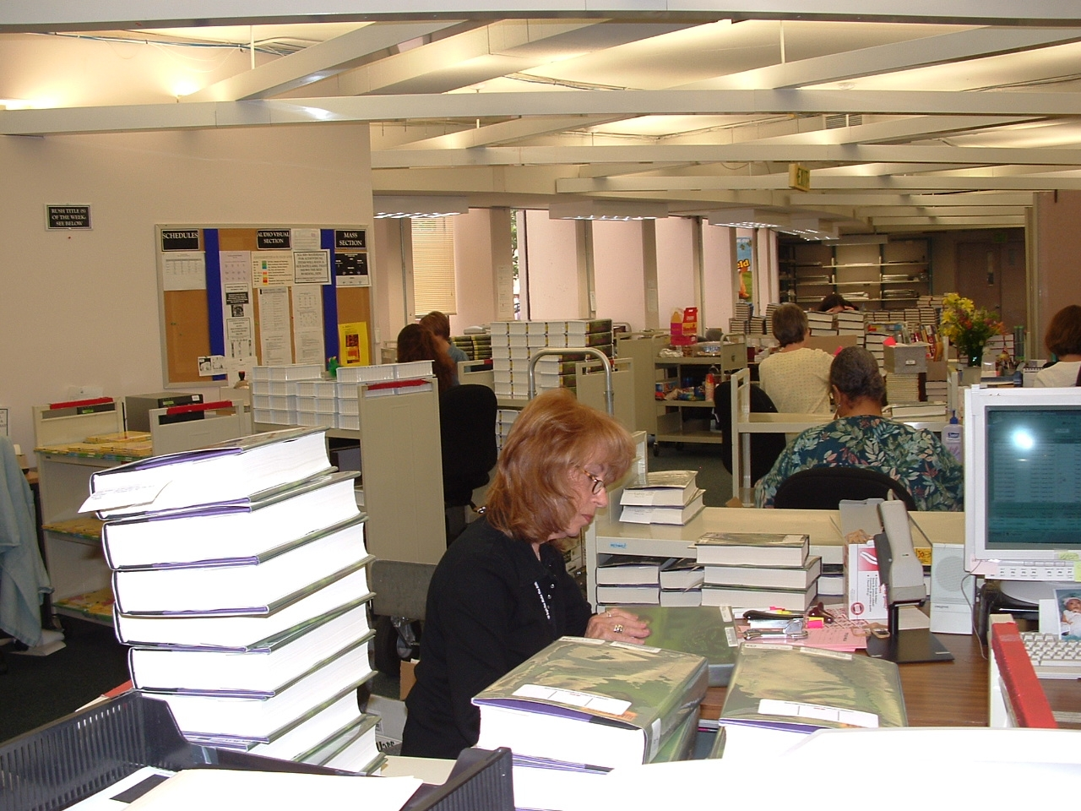
Notes:
The renovation took us From this…

Slide 19
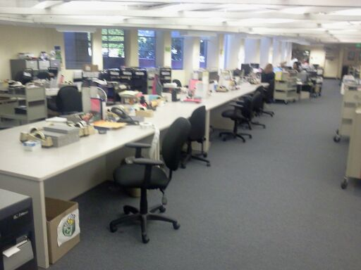
Notes:
To This!

Slide 20
Results
Production rose from 12 carts per day to 20 or more
Fewer, and more predictable, workload peaks and valleys
Productivity UP; Errors DOWN
Loading dock to branch—10 days, often less!
Notes:
So how did it all turn out?
Daily production levels rose from 12 carts per day to 20+.
Coll Dev evened out buying patterns to avoid workload peaks and valleys
Productivity UP; Errors DOWN
Time Certain works! Loading dock to branch—10 days, often less!

Slide 21
More Results
Cart production up 50+%
Reduced per-cart staff time by 35%
Increased per-hour production by 50%
Notes:
Cart production went up 50+%
We reduced staff time spent completing each cart by 35%
We increased our per-hour production by 50%

Slide 22
…And Today
Daily Rounds
Keep refining , rethinking, looking for efficiencies
No more security cases !!
Minimal labeling and handling
20 carts per day is minimum daily output now
2-5 days loading dock to branch shelves
Notes:
Daily Rounds, where we triage and adjust workflow when needed
Keep refining , rethinking, looking for efficiencies
Now all CDs AND DVDs are out of security cases
20 carts per day is minimum daily output now
2-5 days from loading dock to branch shelves is now the norm

Slide 23
Our journey of continuous improvement goes on !
Thank you
James Cooke
jccooke@bcpl.net

